Slide 1
Emotional Intelligence
The Role of EQ in Professional Success

Slide 2
Table of contents
01
Why Emotional Intelligence Matters
02
Emotional Intelligence Staircase
03
Emotional Intelligence & Success
04
Emotional Intelligence in Real Life

Slide 3
01
Why Emotional Intelligence Matters

Slide 4

What Would You Do?
Would you:
React defensively
Shut down
Stay calm, take responsibility, and respond professionally

Slide 5
Hard Skills vs. Soft Skills
In University
In Job Interviews
Hard Skills
Knowledge
GPA Scores
Software Skills
Language Proficiency
Soft Skills
Teamwork
Leadership
Communication
Problem-Solving Skills

Slide 6
02
Definition of Emotional Intelligence

Slide 7
Staircase System

Slide 8
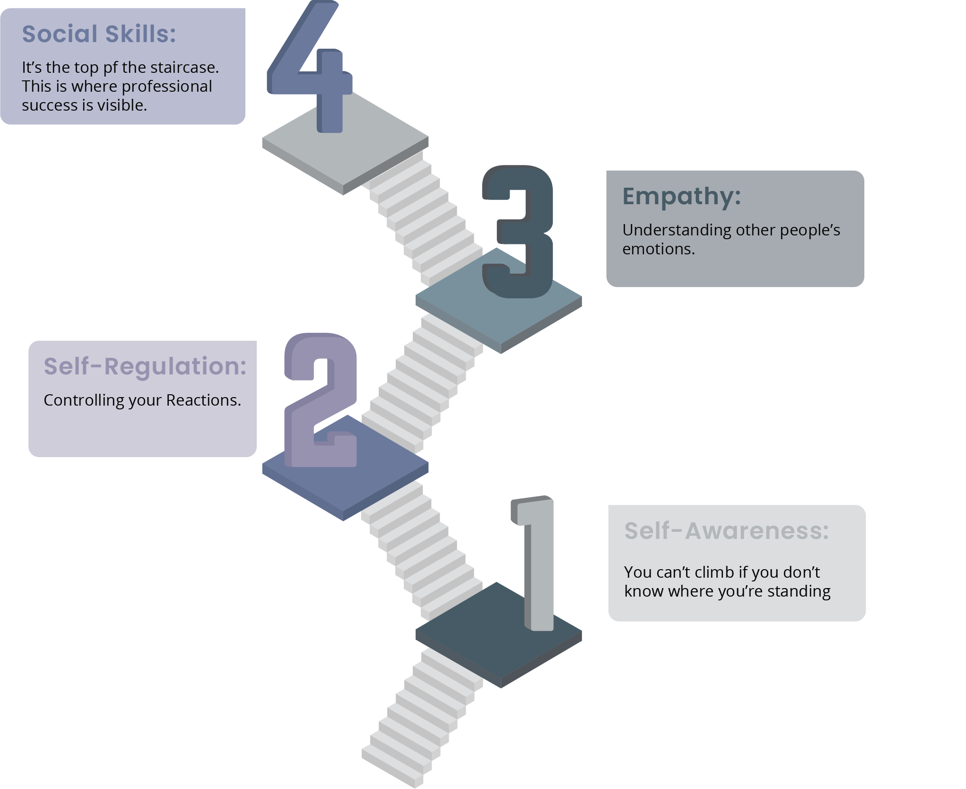

Slide 9
More Than IQ
Grades
Attitudes

Slide 10
A Designer’s Perspective
Turning difficult moments into long-term trust

Slide 11


Slide 12
Thanks!

